Slide 1
Special Features of LAN8670/1/2 and LAN8650/1
June 2024

Slide 2
Agenda
LAN8670/1/2 and LAN8650/1 Review
Features to Tune Bandwidth
Supporting Time Sensitive Networking
Wake/Sleep

Slide 3
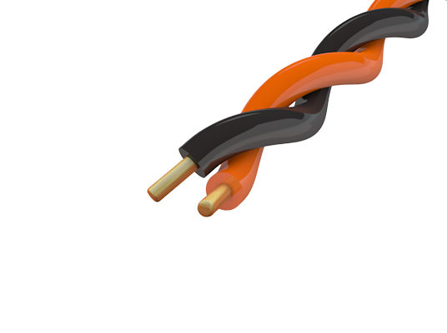
What is 10BASE-T1S?
IEEE 802.3-2022
Ethernet over a balanced pair of conductors
10 Mbps shared
Half duplex multidrop bus line with PLCA
Up to at least 8 nodes*
Up to at least 25m bus length*
*AN1829 demonstrates up to 50 nodes and 100 meters
ECU
Sensor
Sensor
Sensor
Sensor
Notes:
Let’s come to the question: what is 10BASE-T1S ?
It is a technology to connect Ethernet devices using a balance pair of connectors as a bus line.
10BASE-T1S supports a bandwidth of 10 megabits per second on a shared connection.
On a bus line, it uses half-duplex data transmission,
Up to at least 8 nodes, depending on the environment and cableing, can be connected via a multidrop bus.
The bus length can go up from a few cm to at least 25m, and even higher.
Alternatively, on a point-to-point connection, the 10BASE-T1S standard specifies a half-duplex or full-duplex mode, with up to 15m connection length.
The technology is being developed as the IEEE 802.3cg standard,
which envisions low power physical layer transceivers
and a bus line connection without collisions.
10BASE-T1S supports AEC-Q100 Temperature Grade 1 and
Functional Safety requirements, as needed for high-reliability applications.

Slide 4
System Block Diagram - LAN8670/1/2 Family
Sensors &
Actuators
100/1000BASE-TX
MCU
Switch
MAC
MII/RMII
MII/RMII
LAN8670/1/2
LAN8670/1/2
10BASE-T1S bus
Notes:
The LAN8670/1/2 is a high-performance 10BASE-T1S single-pair Ethernet PHY transceiver for 10 Mbit/s halfduplex networking over a single pair of conductors, designed according to the IEEE Std 802.3cg-2019™.
The LAN8670/1/2 connects via an MII or RMII interface to an Ethernet MAC Layer, running on an external MCU. The LAN8670/1/2 can be configured via a standard SMI-interface by the external MCU, and connects to the 10BASE-T1S network using 2 differential pins.
The MCU itself may be connected to several sensors or actuators, collecting and processing their data, or may be connected to any other application.
Similarly, the LAN8670/1/2 may be connected via MII or RMII to an Ethernet switch application which passes the data to/from the 10BASE-T1S network to other network segments having higher speed.

Slide 5
LAN8650/1 MAC-PHY
SPI Interface, 5 pins
OA TC6 V1.1 SPI specification
Works with almost all MCUs
LAN8650: Requires 3.3 and 1.8V supplies
LAN8651: Single 3.3V supply with integrated 1.8V regulator
MCU
MCU
MAC
MII
RMII
SPI
MAC-PHY
PHY
MAC
Digital PHY
Digital PHY
Analog PHY
Analog PHY
Notes:
The LAN8650/1 is a high-performance 10BASE-T1S MAC-PHY for 10 Mbit/s halfduplex networking over a single pair of conductors, designed according to the IEEE Std 802.3cg-2019™.
The LAN8650/1 connects via an SPI interface to an external MCU. The LAN8650/1 can as well be configured via the SPI interface by the external MCU, and connects to the 10BASE-T1S network using 2 differential pins.
The MCU itself may be connected to several sensors or actuators, collecting and processing their data, or may be connected to any other application.

Slide 6

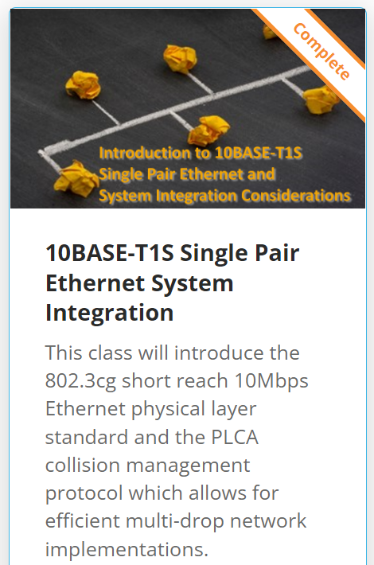
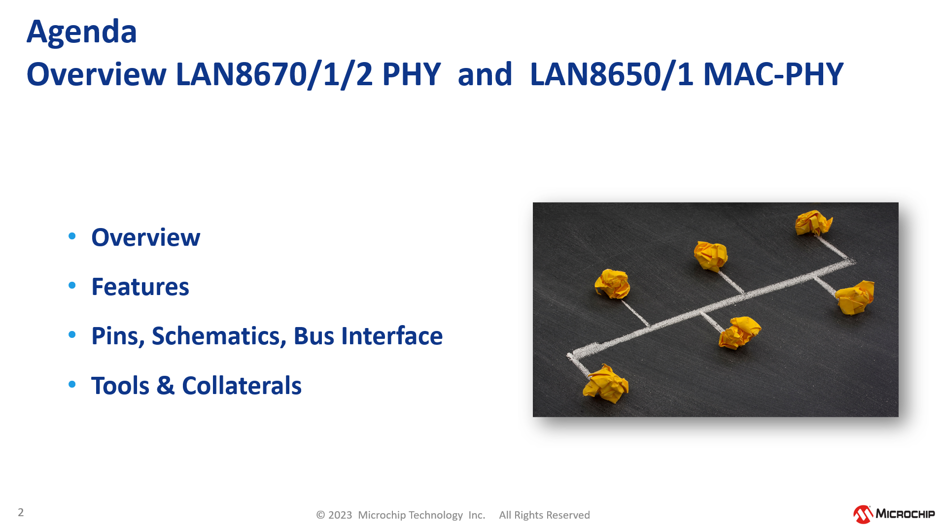
References
Presentation
&
10base-t1s-single-pair-ethernet-system-integration
~1 hour
10BASE-T1S,
PLCA,
Live Demo using MCHP Eval Boards,
Analysis of Network Bandwidth

Slide 7
Agenda
LAN8670/1/2 and LAN8650/1 Review
Features to Tune Bandwidth
Supporting Time Sensitive Networking
Wake/Sleep

Slide 8
PLCA - Basics
Organize Media Access
Physical Layer Collision Avoidance
(PLCA) IEEE 802.3cg
Unique Node IDs
0
1
2
3
4
Notes:
The key is to avoid physical collisions by organizing the media access,
This IEEE standard is called Physical layer collision avoidance, or just PLCA in short.
One of the basics for PLCA is that each node has its unique NodeID, but the order of the Ids in the network is not relevant.

Slide 9
PLCA - Basics
Round Robin
…
0
1
2
3
N
Notes:
Transmit opportunities are given in a round robin manner to each node.
And only the node that owns a certain transmit opportunity is allowed to send its data .
This rule avoids collisions on the bus line.

Slide 10
PLCA - Basics
Transmit Opportunity (TO) of Node N
BEACON
PLCA Coordinator
Node-0
TO from
PLCA Follower
Node-1,2...N
Silence
TO-N
0
B
0
TO-0
0
TO-1
0
TO-2
0
…
TO-N
0
B
0
TO-0
0
TO-1
time
PLCA Bus Cycle
Notes:
Every transmit opportunity is followed by a short silence to make sure that all nodes have recognized the beginning of the next transmit opportunity .
Once all transmit opportunities have passed, this is called a PLCA bus cycle.
A new PLCA bus cycle is started right away by sending out a beacon signal from the PLCA coordinator device which is node zero.
All other devices, called PLCA-Followers, synchronize their internal timings to this BEACON, to know when their TO starts.

Slide 11
Increasing Node Bandwidth
Burst
Multiple Transmit Opportunities

Slide 12
Burst Mode
3 frames in TO-1
3 x more frames
per cycle
Max Burst Count = 2 (additional frames)
…
TO-5
B
0
TO-1: #1
TO-1: #2
TO-1: #3
2
3
TO-4
5
B
…
No Silence
Silence
Notes:
Burst Mode is feature of PLCA , to enhance the bandwidth which can be used by a specific node.
In this example Node-1 can send three Ethernet frames (the yellow ones) without interruption in the same TO. The node just needs to be configured with a Maximum Burst Count setting of 2, and that means 2 additional frames.
As a result, Node-1 can potentially send 3 times as many frames per cycle compared to the other nodes.
Note that there is no silence between the frames of a burst, but at the end of the 3 frames.

Slide 13
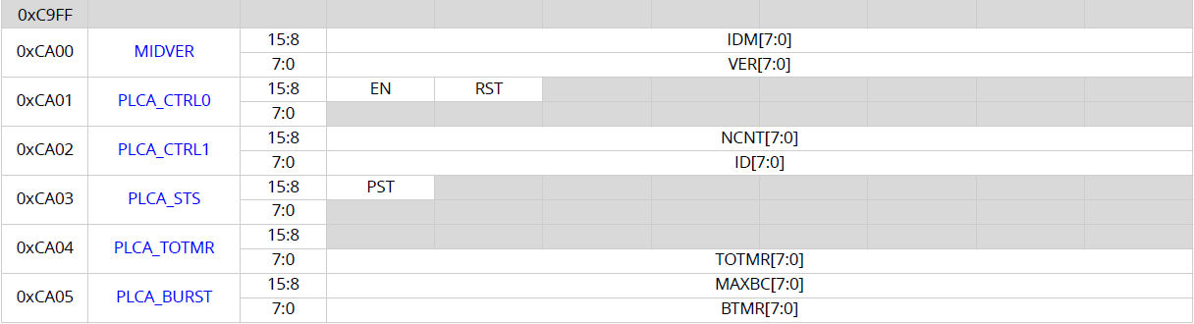
Controlling Burst: PLCA_BURST Register
LAN8670/1/2: MMD 0x1F
LAN8650/1: MMS4
Burst timer
= max time between two frames of the burst
Max burst count
= number of add. frames per TO
This feature is described in the IEEE standard, but the registers are not. All PHYs have this feature.

Slide 14
Multiple Transmit Opportunities / Node IDs Example
Node_Ids #1, #3, #5
Assigned to same device
Reduced latency,
more bandwidth
for this node
ID=0
ID=2
ID = 1
ID1 = 3
ID2 = 5
ID=4
…
TO-5
B
0
TO-1
TO-2
TO-3
TO-4
TO-5
B
…
No need to wait for next bus-cycle
Notes:
Assigning Multiple NodeIDs to a single node is an advanced feature of the LAN867x and LAN865x, to enhance the latency and bandwidth for a specific node.
In the example one of the devices has been assigned the three nodeIDs, #1, #3 and #5 (the yellow ones).
After the transmission in TO-1, followed by a short silence, the TO-2 is used by some other device. However, our local device can use already TO-3 for its next frame, instead of waiting for a full PLCA bus-cycle. This reduces the latency for the local device, even if TO-0, 2, and 4 are used by other devices. Also the available bandwidth for the local device increases.

Slide 15
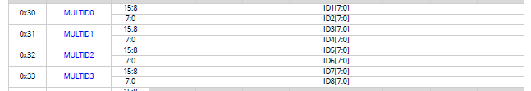
Controlling Multiple Transmit Opportunities
LAN8670/1/2: MMD 0x1F
LAN8650/1: MMS4
Additional TOs
(up to 8)
This feature is unique to Microchip PHYs. It work with on a bus with any standard compliant PHYs.

Slide 16
Decreasing Node Bandwidth
Transmit Opportunity Skipping
Credit Based Shaper

Slide 17
Transmit Opportunity Skipping
If a node does not transmit often, it can be configured to ignore a set number of TOs after each packet it transmits.
This is only useful it a low bandwidth node has bursty, non-time critical data.
Notes:
It is almost always possible to adjust bandwidth by giving some nodes more bandwidth using either Burst or Multiple Transmit Opportunities. Given that Ethernet won‘t try to transmit if it doesn‘t have something, it is rare to need to reduce bandwidth. The easiest ways to reduce bandwidth is transmit opportunity skipping.

Slide 18
Controlling Transmit Opportunity Skipping
LAN8670/1/2: MMD 0x1F
LAN8650/1: MMS4
TO Skipping
Enable
Number of TOs
to Skip
Configure the number of TOs to skip before enabling the mode
This feature is not in the standard but is found in other PHYs (the control registers will be different). It work with on a bus with any standard compliant PHYs.

Slide 19
CBS – Credit Based Traffic Shaping
Provides a node a certain bandwidth based on credits.
Prevents a “best-effort-node” from flooding the network
This is NOT MAC-based traffic shaping – there are no queues
Bandwidth distribution independent of Ethernet frame length
HW-based: Application only needs to configure
Do not mix with PLCA Burst Mode
Does not require PLCA (functions in CSMA/CD mode)
This feature is unique to Microchip PHYs. It work with on a bus with any standard compliant PHYs.
Enables
traffic shaping in small MCUs
Notes:
The LAN8670/1/2 and LAN8650/1 implements a hardware credit based traffic shaper (CBS) to control the station’s transmit bandwidth. A hardware credit counter is used to enable and disable the ability to transmit packets onto the medium. The PHY decrements the credit counter during transmit and increments the counter when the PHY is receiving data or the medium is idle. When the credit counter is below the stop threshold, the PHY does not have enough credits to begin transmitting a packet, however it will complete the current packet, regardless of length. Once below the threshold and no longer transmittion, the PHY will then hold the MAC off from transmitting by asserting carrier sense (creating a logical collision). When the PHY is not transmitting, it will accumulate credits. Once the credit counter exceeds the start threshold, carrier sense will operate normally.
The CBS is harder to debug and configure than transmit opportunity skipping. Nodes cannot use burst mode (so that may need to be disabled in a driver).
Because PLCA uses bandwidth more efficiently than CSMA/CD, CSMA/CD should only be used during start-up or error recovery. During these phases, there is no need for bandwidth control.

Slide 20
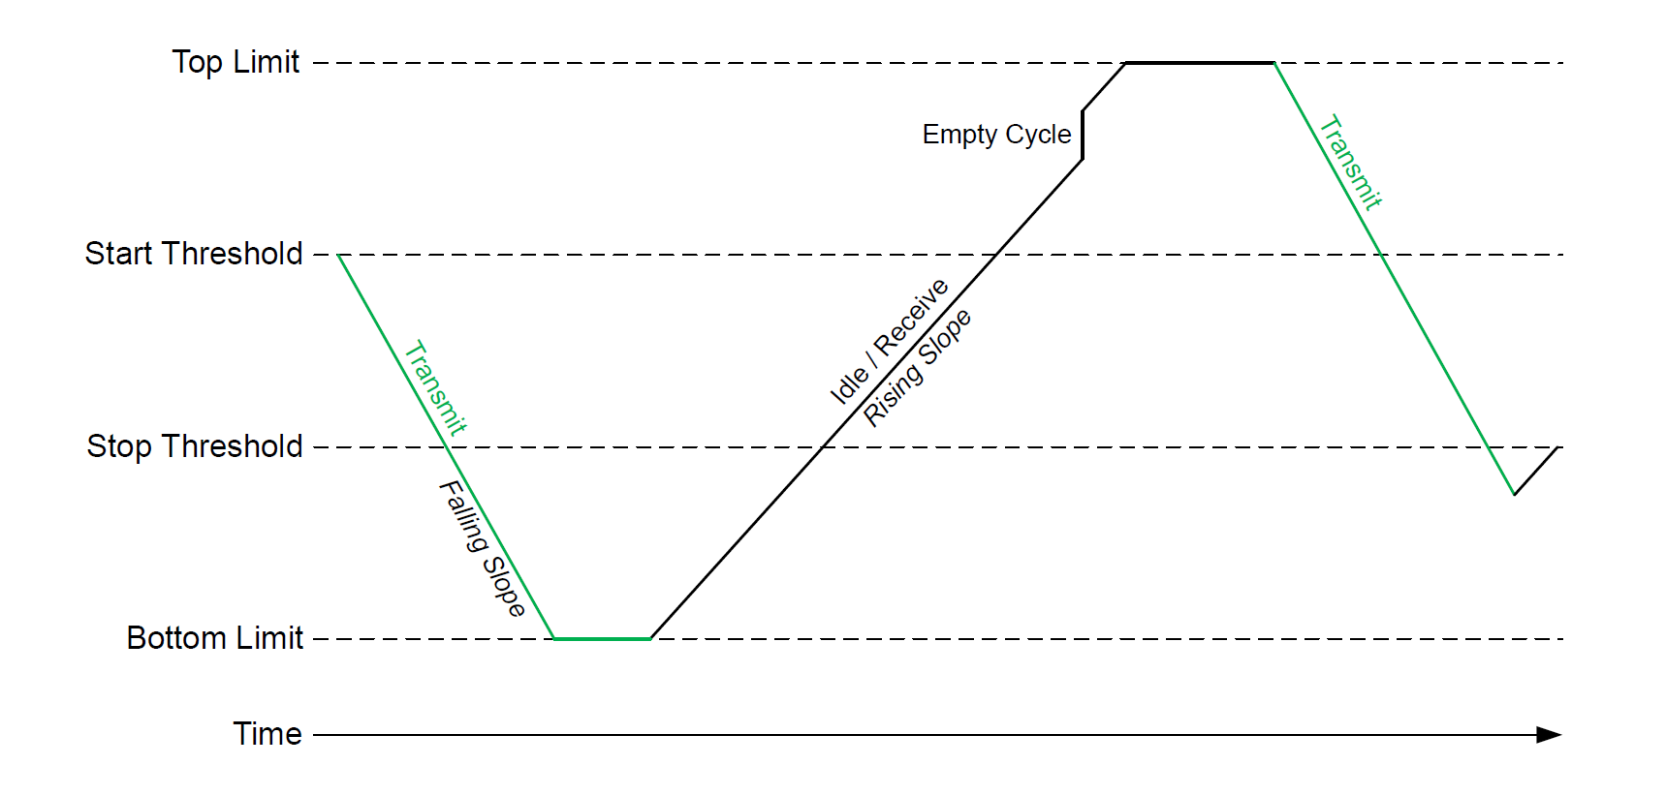
No more increment when
credits > TOPLIMIT
prevents bursts of packets
RISESLP (Rising Slope)
30 Bytes RX or 800 ms idle => +1 Credit
ECCRDS (empty Cycle Credits)
1 empty PLCA cycle
=> +30 Credits
Credit Based Traffic Shaping
LAN8670/1/2
&
LAN8650/1
PHY starts TX only if
credits > STARTTHR
PHY stops TX when
credits < STOPTHR
Packet sent completely,
even when
credits < STOPTHR
FALLSLP (Falling Slope)
2 Bytes TX
=> -1 Credit
No more decrement when
credits < BOTLIMIT
prevents waiting for too long
Notes:
The PHY can only start transmitting when its credits are higher than the start threshold. Once the PHY allows the MAC to begin transmitting a packet, the entire packet will be transmitted even if the credit counter decrements below the stop threshold while it is transmitting.
The Falling Slope (FALLSLP) field of the Credit Based Shaper Slope Control (CBSSLPCTL) register configures the rate at which the credit counter loses credits when transmitting. Similarly, the Rising Slope (RISESLP) field configures the rate at which the credit counter will accumulate credits when the medium is idle or the PHY is receiving data.
When PLCA is enabled, credits may additionally be accumulated at an accelerated rate when no transmission is detected within each PLCA bus cycle. The rate at which credits are accumulated for each empty PLCA bus cycle is configured by the Empty Cycle Credits (ECCRDS) field.
The credit counter will saturate and stop accumulating credits when the limit set by the Top Limit (TOPLIMIT) field in the Credit Based Shaper Top Limit High/Low (CBSTPLMTH/CBSTPLMTL) registers is reached. Likewise, the credit counter will saturate and stop losing credits at the limit set by the Bottom Limit (BOTLIMIT) field. This prevents the credit counter from incrementing or decrementing into an overflow condition. The saturation of the credit counter also prevents the PHY from delaying transmission of a packet too long or transmitting a burst of packets. For example, the PHY may lose a significant number of credits by transmitting a maximal size packet. If the credit counter were not limited by a lower bound, it may take a significant amount of time for the PHY to accumulate enough credits to transmit another packet. Similarly, if the PHY has not transmitted in a long time, it may accumulate too many credits allowing it to transmit multiple frames if the credit counter were not limited by an upper bound. By controlling the top and bottom limits of the credit counter, the credit based shaper may be configured to transmit at the desired rate.

Slide 21
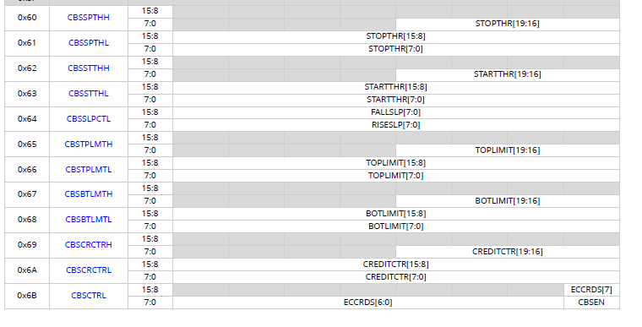
Controlling CBS
Stop Threshold: 20 bits
Slope Control: 8 bits each for FALLSLP and RISESLP
Start Threshold: 20 bits
Extra Increment for Empty Cycles
Top Limit: 20 bits
Bottom Limit: 20 bits
Enable Bit
Current Credit Count: 20 bits
(Read-only – debug use)

Slide 22
Summary of CBS Configuration
Less bandwidth available for certain nodes:
Start/stop threshold can be configured differently in each node
Higher start threshold => node needs to wait longer for TX
Higher stop threshold => node needs to stop earlier when TX

Slide 23
Time Division Multiplexing
ACMA

Slide 24
Reminder: PLCA Bus Cycle
Transmit Opportunity (TO) of Node N
BEACON
PLCA Coordinator
Node-0
TO from
PLCA Follower
Node-1,2...N
Silence
TO-N
0
B
0
TO-0
0
TO-1
0
TO-2
0
…
TO-N
0
B
0
TO-0
0
TO-1
time
PLCA Bus Cycle
Notes:
Every transmit opportunity is followed by a short silence to make sure that all nodes have recognized the beginning of the next transmit opportunity .
Once all transmit opportunities have passed, this is called a PLCA bus cycle.
A new PLCA bus cycle is started right away by sending out a beacon signal from the PLCA coordinator device which is node zero.
All other devices, called PLCA-Followers, synchronize their internal timings to this BEACON, to know when their TO starts.

Slide 25
Application Controlled Multiple Access (ACMA)
ACMA 0
…
ACMA 0
ACMA 1
ACMA 2
ACMA N
Channel 0
Channel 1
Channel 2
…
Channel N
Channel 0
time
ACMA Bus Cycle
Notes:
Each device can only begin transmission when its ACMA pin is asserted. ACMA is set for active high in this example.
Device 1 can start to transmit when ist ACMA input is high.
So can device 2.
And so on.
We see with device N, when it doesn‘t have something to transmit, it can still begin tranmitting any time that ACMA is asserted.
And it will transmit a complete packet, regardless of length. So the ACMA pulse timing must allow for the worst case packet length, plus some extra for jitter.
The ACMA pulses need to be synchronized, so you either need and external clock, or you need to run a clock sychronization algorithm. This take development effort, debug time, plus code and data memory and processor cycles.
For Watson, ACMA uses IO pins that may be better used for something else. If you are using ACMA, you need to make sure that you have a pin available for RXPI if you will be using PTP to synchronize your clock.
For Galileo, you can use the internal event generator 0 as a source for ACMA if you can synchronize the wall clock.

Slide 26
Common Configuration
ACMAPOL =1 (ACMA Polarity)
in PINCTRL (Pin Control Register)
ACMAEN =1 (ACMA Enable)
in ACMACTL (ACMA Control Register)
Debugging:
UNCRS (Unexpected Carrier Sense)
in STS1 (Status1 Register) can
Be signaled via interrupt

Slide 27
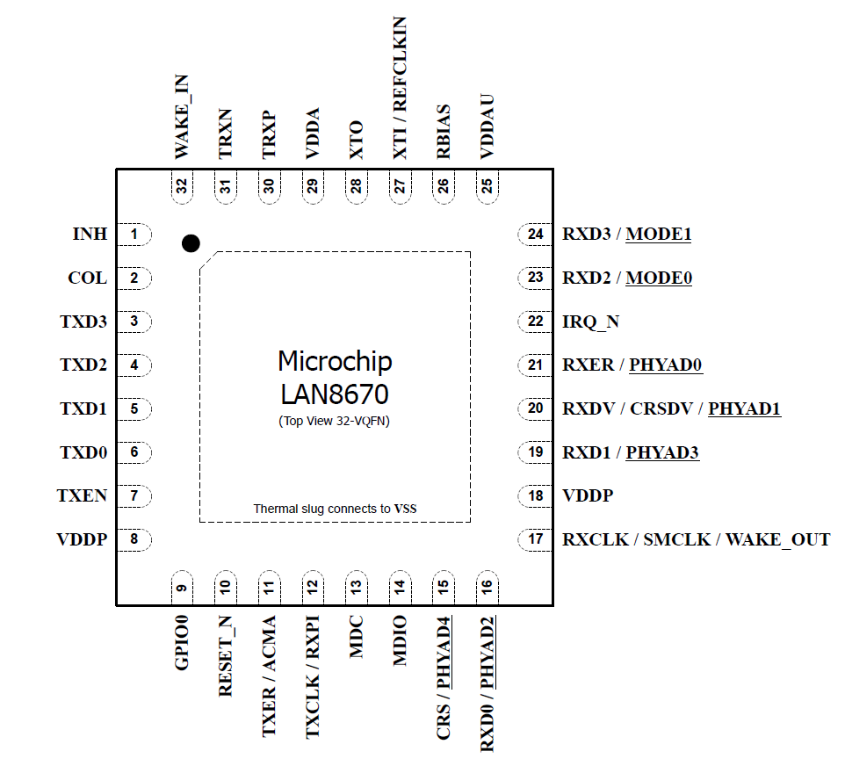
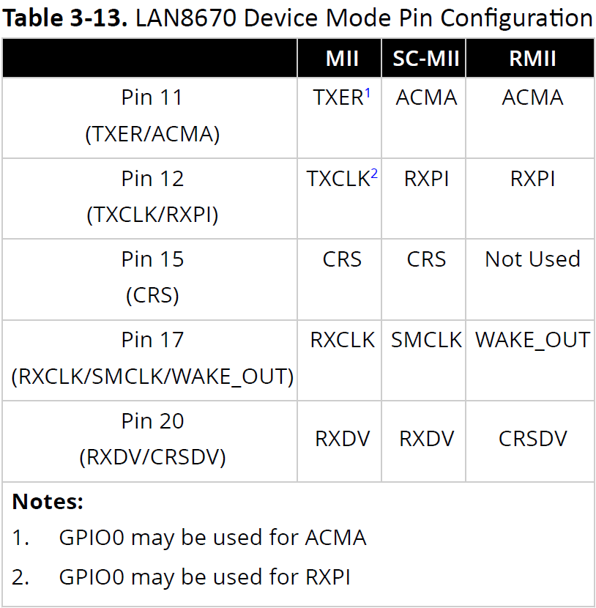
LAN8670 in RMII Mode
RMII Interface
Dedicated ACMA pin available
in RMII / SC-MII mode, if enabled
ACMA pin available
in each LAN867x variant
Sometimes muxed with other functions
Notes:
The LAN8670 supports a dedicated ACMA pin in SC-MII mode and in RMII mode.

Slide 28
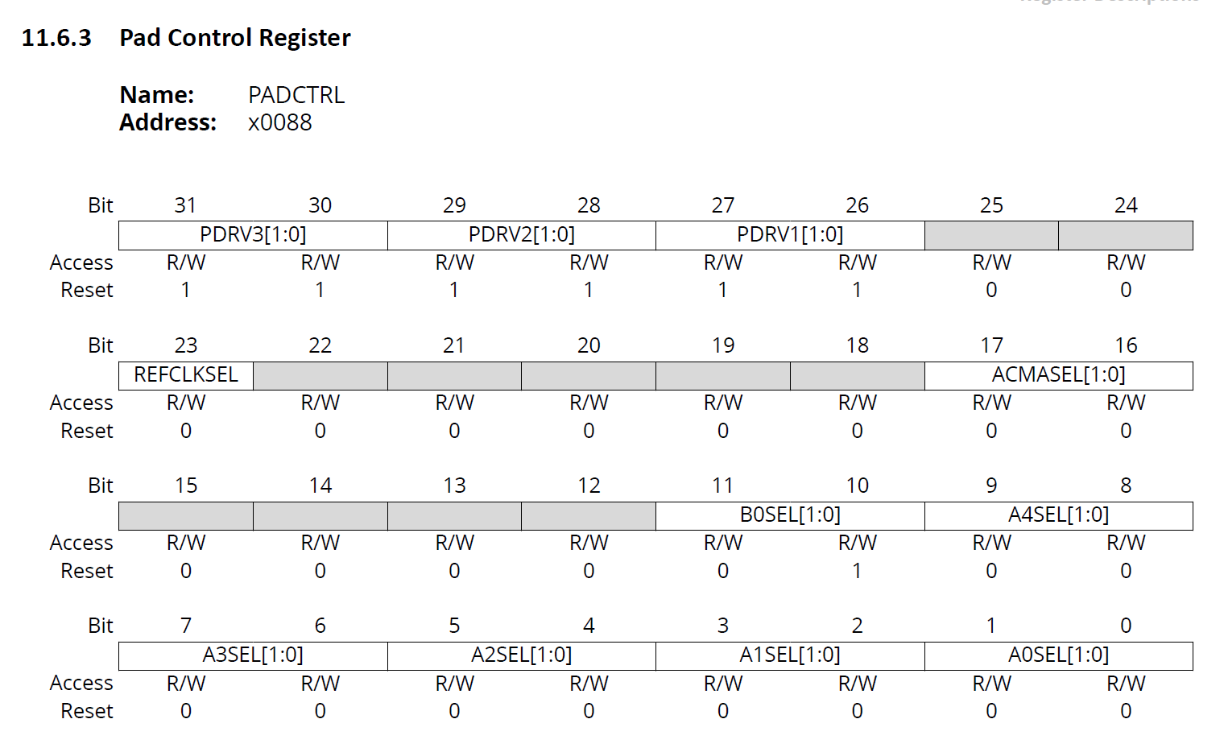
LAN8650 ACMA
ACMA-signal can either be generated internally
Internal or External Source
ACMASEL = 01 ACMA-signal by EG0 (Event Generator 0) internally passed to PHY
ACMASEL = 10 ACMA-signal input on DIOA2 from external MCU, passed to PHY
Or
it can be an external input from MCU into DIOA2 pin
A2SEL = 00 ACMA-signal input from external MCU
A2SEL = 01 DIOA2 signal output from Event Generator 2
Miscellaneous Registers (MMS 10)

Slide 29
Agenda
LAN8670/1/2 and LAN8650/1 Review
Features to Tune Bandwidth
Supporting Time Sensitive Networking
Wake/Sleep

Slide 30
What is Time Synchronization
Notes:
Time Synchronization enables all devices on a network to have a common time reference. This allows data to be sampled and events to occur at known times.
The reference can be several hops away provided the bridges between segments are time aware. All time aware endpoints can synchronize to the wallclock provided by the time aware bridge, which synchronizes to the grandmaster.
For any endpoint, we just need to look at how it gets ist clock from it‘s local clock source.

Slide 31
Clock Synchronization
We need to match the clock in the sink to clock in the source
And STAY matched
Both clocks increment based on local oscillators
Oscillators are never exactly the same
If the oscillators appear to match but there is a phase offset, the clocks are syntonized

Slide 32
Possible Software Architecture
Clock Servo
Algorithm
X
+
Reference Clock
-
Local Wall Clock
Periodically get updates from an external reference, use a servo control algorithm to minimize the error between the clock
This is not good enough – there will always be a processing delay!

Slide 33
Better Software Architecture
Local Wall Clock
+
Clock Servo
Algorithm
Increment (ns.subns)
Reference Clock
-
Periodic updates from an external reference, use a servo control algorithm to minimize the error by changing the amount the local clock is incremented every tick of the local oscillator.
First time through – set the wallclock as on the previous slide
This architecture works!

Slide 34
But LAN8650/1 Updates via SPI?
SYNC messages are sent very slowly (8 – 16 per second)
At least 62.5 milliseconds between updates
Receive timestamps are directly passed with the Ethernet data (no register reads).
Clock servo will update 0 to 2 registers each SYNC
Even over SPI, the updates can be made in a timely manner
Control accesses are interleaved with packet data
@15MHz, SPI will handle the full Ethernet bandwidth
There is room for the few control accesses.
Because only the INCREMENT registers change, a slow interface will work
A clock servo for a faster system will probably need some adjustment

Slide 35
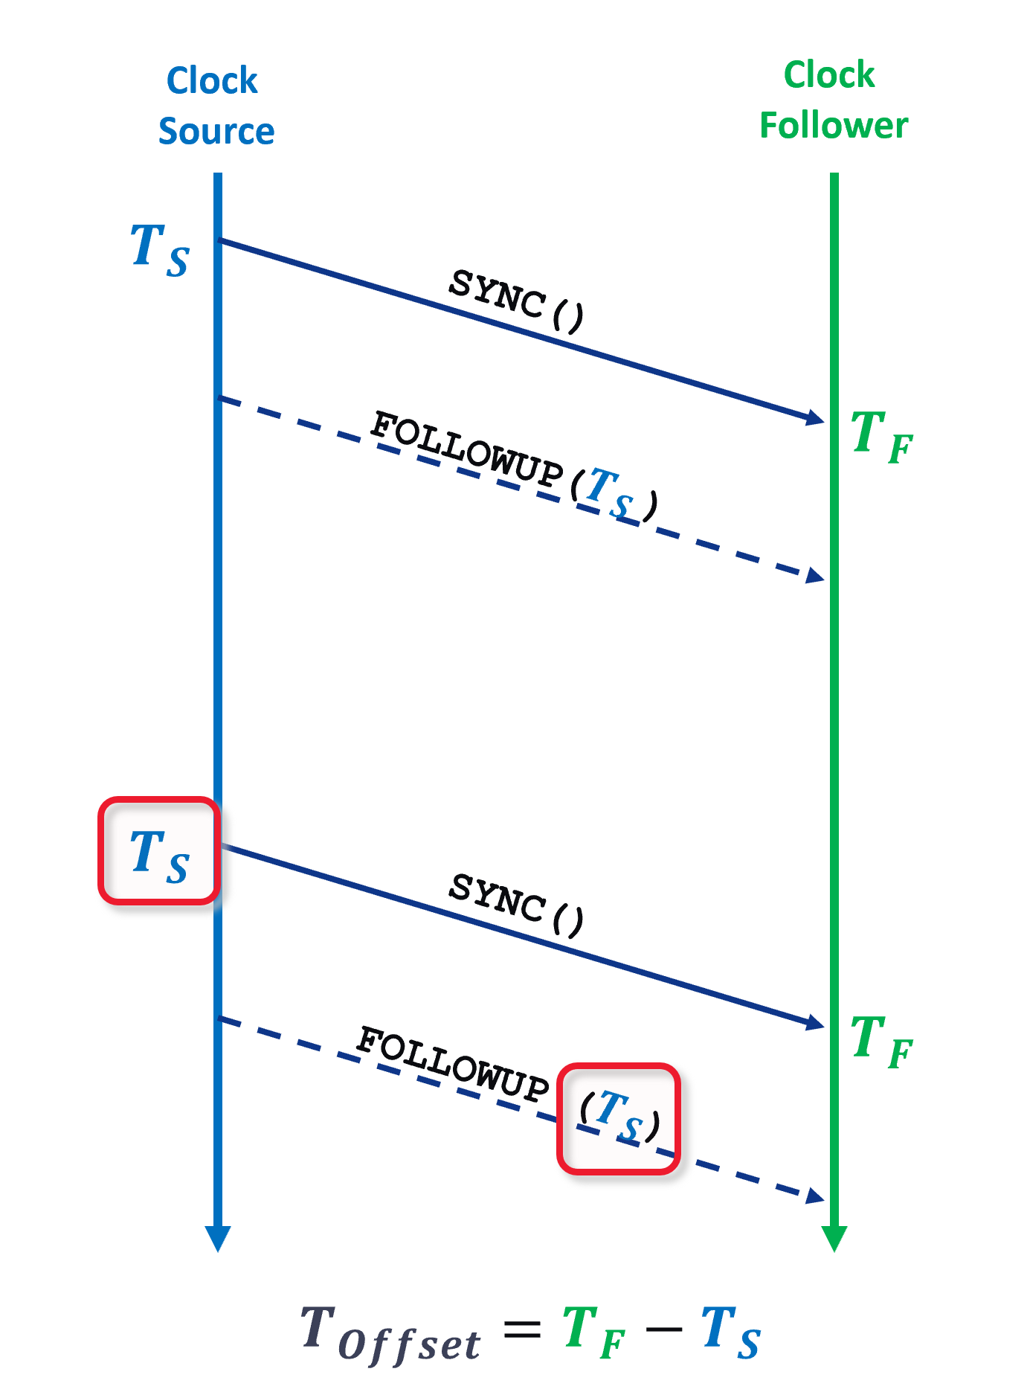
How does the Clock Source Share It‘s Time?
The Precision Time Protocol contains messages to share the time from the clock source
SYNC message is sent from the source. It timestamps exactly when the messsage is sent, T_{S}.
The follower captures a timestamp when it receives the SYNC message, T_{F}.
The source sends a FOLLOWUP message containing T_{S}.
The follower now has 2 timestamps:
T_{S} and T_{F}

Slide 36
What is the Real Time at the Follower?
If there were no propagation delay, then T_{F} and T_{S} would be the same.
Call the propagation delay T_{D}. The error at the follower is:
δ = T_{F} – (T_{S} + T_{D})
How to determine T_{D}?
For larger networks, the Pdelay_resp and Pdelay_followup messages from PTP can be used to exchange another set of timestamps.
With all 4 timestamps, it is possible to calculate roundtrip delay.
For 10BASE-T1S networks, the distance between nodes is known so the delay can be calculated and treated as a constant.

Slide 37
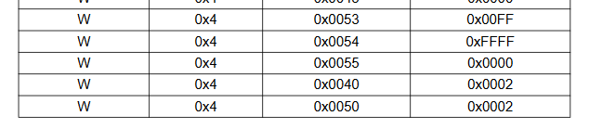
LAN8650/1 Receive Timestamp Configuration
The standard software configuration will set the pattern matcher to trigger a timestamp on ALL incoming packets.
First 3 writes configure a timestamp to be taken at the end of the SFD (Source Frame Delimiter) symbol in the Ethernet frame based on the internal wall clock
Last write enables the signal which triggers the timestamp

Slide 38
LAN8650/1 Wall Clock Registers
To set the wall clock (used once at the start of the clock servo)
MAC_TSH, MAC_TSL (48 bits of seconds)
MAC_TSN (30 bits of nanoseconds)
To set the amount the wall clock is incremented each tick of the local osillator
MAC_TI (8 bits of nanosecond adjustment)
MAC_TISUBN (24 bits of sub-nanosecond increment)
If a one time adjustment is needed
MAC_TA (30 bits of nanoseconds, plus a sign bit)

Slide 39
LAN8650/1 Software
The TC6 driver software handles all features of the protocol
Set the FTSE (Frame Timestamp Enable) bit to provide timestamps on received packets.
Timestamps are delivered as part of the implementation. If enabled, they will be delivered in the payload structure.
They can be ignored by higher level packets unless they are explicitly needed
The clock synchronization software will process PTP packets and pass the timestamps to the clock servo algorithm.

Slide 40
Optional: Filter for SYNC Packets
Arbitrary RX/TX Ethernet frame
Pattern Matcher can
check 3 Bytes
in RT/TX Ethernet frame
Pattern for SYNC:
0x 88 F7 10
In case of a match
either RXPI, TXPI or RXTXPI pin is asserted
according to pin configuration
Configured in TXMPATH
(TX Match Pattern High)
Configured in TXMPATL
(TX Match Pattern Low)
Notes:
The LAN86xx supports the implementation of PTP over Ethernet within the station controller by
being able to detect the exact time of transmission and reception of PTP messages. This is done by
examining the bytes of a packet that contain the EtherType and the first 2 bytes of the PTP header, and signaling when the correct pattern is detected.
To configure the desired pattern on transmitted packets, the most significant byte of the desired
value is written into the Transmit Match Pattern High (TXMPATH) register and the lower two octets of
the match value is written into the Transmit Match Pattern Low (TXMPATL) register. As an example,
to match on a SYNC message, the EtherType value of 0x88F7 and PTP header value of 0x10 creates
a 24-bit match value of 0x88F710. The value 0x88 is written into TXMPATH and the value 0xF710 is
written into TXMPATL.
Configuring the receive pattern matcher is done in a similar manner but using Receive Match Pattern High (RXMPATH) register and Receive Match Pattern Low (RXMPATL) register.
Pattern match output pins can be used on both transmitted and received packets.

Slide 41
LAN8670/1/2 Timestamping
PTP relies on exact timestamps (Ts) broadcasted regularly (e.g. every 125 ms) in SYNC or FOLLOWUP messages by the Clock Source. All Clock Followers use this exact timestamp Ts to calculate the offset to their own time Ts.
Receiving a SYNC message (or any frame) is done without PLCA buffer, adding only internal fixed delays of PHY, MAC and stacks. Similar to LAN8650 except that there is no SPI protocol
Sending a SYNC message over a PLCA-based network adds a variable delay of 0-40 µs caused by the PLCA sending buffer when waiting for the own transmit opportunity and leads to an outdated timestamp Ts.
LAN8670/1/2 has two operational modes to solve this problem:
MCU
Transmit Match Enable
PHY recognizes an ingress/egress SYNC at its MDI
PHY informs MCU via GPIO
MCU can now compensate any delay in its time stamps due to PLCA or internal reasons (e.g. By using FOLLOW-UP messages)
MCU/
MAC
MAC Transmit Time Stamp Enable
PHY signals a logical collision to the MAC when it starts sending a SYNC.
MAC will backoff and retry the SYNC with an updated timestamp Ts.
This retry will pass the PHY without PLCA buffer, i.e. having an exact timestamp.
MAC
MII
GPIO
PHY
PLCA
PHY
PLCA Buffer
Timestamp at MDI
MII
PCS
PMA
SYNC
FOLLOWUP(Ts)
10BASE-T1S

Slide 42

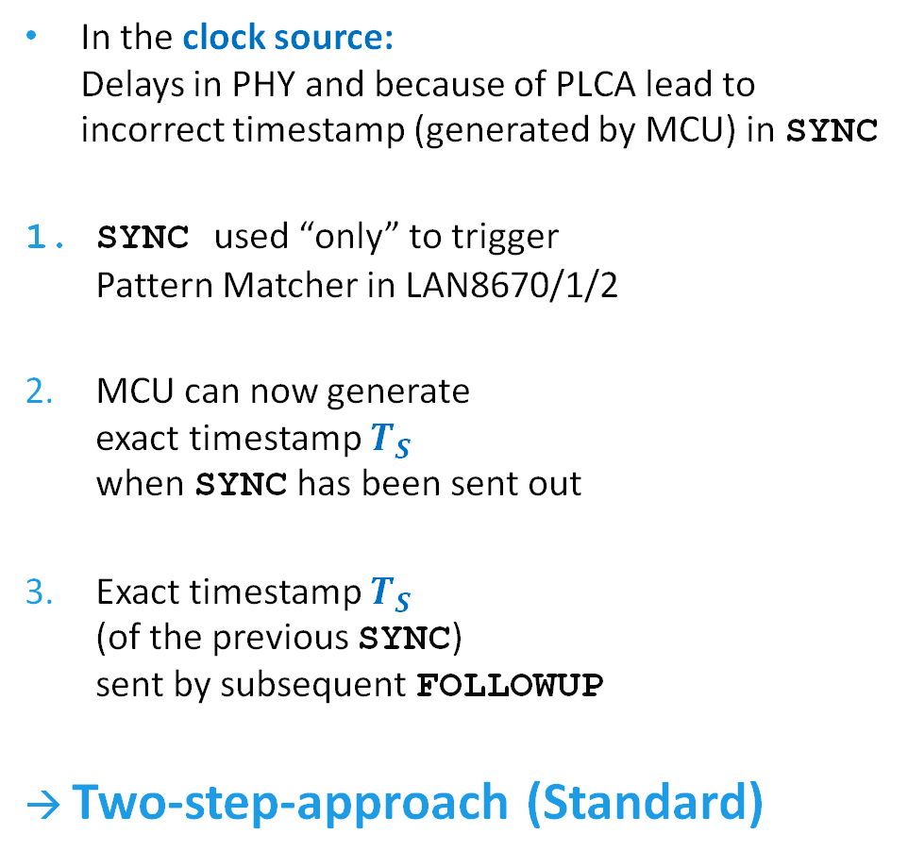






IEEE 802.1AS – Clock Synchronization (Standard)
Clock
Source
Clock
Follower
In the clock source: Delays in PHY and because of PLCA lead to incorrect timestamp (generated by MCU) in SYNC
SYNC used “only” to trigger Pattern Matcher in LAN8670/1/2
MCU can now generate exact timestamp $T_{S }$ when SYNC has been sent out
Exact timestamp $T_{S }$ (of the previous SYNC) sent by subsequent FOLLOWUP
→ Two-step-approach (Standard)
$$T_{S }$$
SYNC()
$$T_{F }$$
FOLLOWUP($T_{S }$)
1a.TXPI
2.
MCU
Pattern Matcher
PLCA
$$T_{S}$$
1.SYNC
SYNC()
3.FOLLOW-UP
$$T_{F}$$
FOLLOWUP ($T_{S}$)
$$T_{Offset}=T_{F}−T_{S}$$

Slide 43
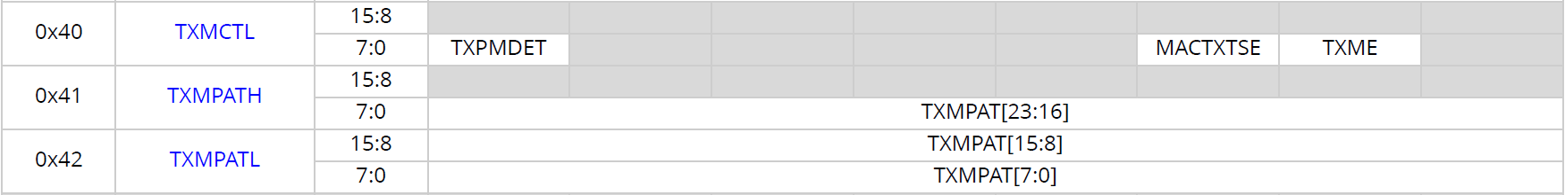
IEEE 802.1AS – LAN8670/1/2 Configuration for Standard Clocksynchronization
“Two-step-approach” (Standard)
Configure Pattern Matcher to detect TX SYNC packets (or other PTP message)
TXME = 1 (Transmit Packet Match Enable)
in TXMCTL (Transmit Match Control Register)
MACTXTSE and TXME cannot be set at the same time.
Functionalities mutually exclude each other.
In case of a match, the TXPI pin will be asserted to inform MCU.
MCU sends a FOLLOWUP, with previous TS

Slide 44
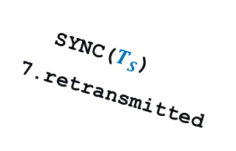






IEEE 802.1AS – Clock Synchronization (MAC Timestamping)
In the clock source:
Many MACs can capture their own transmit time stamps
However, TX PHY delay is variable (0...39,6 µs) because of PLCA elastic buffer
LAN8670/1/2 can be configured to make MAC Timestamping work
Patern Matcher detects TX-SYNC and triggers PLCA module
PLCA emulates collision to MAC
MAC terminates TX-SYNC and backs off
PLCA asserts Carrier Sense to keep MAC waiting until its next TO arrives
PLCA sends COMMITS to hold its TO
PLCA releases Carrier Sense
MAC retransmits SYNC with no delay
Clock Source
Clock Follower
$$T_{S }$$
SYNC()
previous
$$T_{F }$$
MAC
PLCA
Pattern Matcher
1.SYNC()
Buffer
SYNC()
3.aborted
2.COL
trigger
4.CRS
5.COMMIT
6.release
7.SYNC
(updated Ts)
$$T_{S}$$
SYNC($T_{S}$)
7.retransmitted
FOLLOWUP ($T_{S}$)
$$T_{F}$$
$$T_{Offset}=T_{F}−T_{S}$$

Slide 45
LAN8670/1/2 Configuration for MAC Timestamping
“One-step-approach”
In case of a match, the PLCA module will be triggered to
signal a logical collision to the MAC,
CRS is asserted until the next TO arrives,
and retransmitted SYNC can bypass the PLCA buffer.
Configure Pattern Matcher
to detect TX SYNC packets
(or other PTP message)
MACTXTSE =1
(MAC TX Time Stamp Enable)

Slide 46
Agenda
LAN8670/1/2 and LAN8650/1 Review
Features to Tune Bandwidth
Supporting Time Sensitive Networking
Wake/Sleep

Slide 47
Wake / Sleep
As required in TC 10: Enables Wake/Sleep on small MCUs without external components
Sleep mode
Ultra low power consumption (<= 140 μW)
Just constant 3.3V power supply during sleep, but no switched power
Go to sleep via command from host
Wake from...
Remote network Wake-Up Tone (WUT) (MDI)
Local event (WAKE_IN), e.g. user input
Activate switched power
INH pin output to enable/disable power supply
Forward wake signal
Via WAKE_OUT to wake other local devices
Via WAKE_OUT to inform MCU that network re-assumed operation
Via activity* on MDI to wake other devices
*LAN8670/1/1 Rev C and LAN8650/1 Rev B: MDI wake signal and detection does not meet the OPEN Alliance 10BASE-T1S Sleep/Wake-up Specification, version 1.0.
Device will wake on any activity on MDI, not just Wakeup-messages.
LAN8670/1/1 Rev D and LAN8650/1 Rev C: react only to Wake up Signal specified in OPEN Alliance 10BASE-T1S Sleep/Wake-up Specification, version 1.0
Notes:
Note: In the LAN8670/1/2 and LAN8650/1 MDI wake detection was not designed to meet the OPEN Alliance
10BASE-T1S Sleep/Wake-up Specification, version 1.0. Received energy that is of sufficient length
that is detected either from other nodes transmitting onto the segment or from noise will trigger the
device to wake when MDI wake-up is enabled.

Slide 48
Simple System without Sleep Mode
VDDA = power supply voltage for analog parts of the chip
VDDP = power supply voltage for digital parts of the chip
VDDAU = uninterruptible analog supply voltage
VSS = common ground exposed pad must be connected to the ground plane with a via array.
VDDA, VDDP, VDDAU
all connected to same
3.3V power supply
VDDAU only needed for wake detection in sleep mode
Since Sleep mode not used:
INH: no connect
WAKE_IN: connect to VSS
WAKE_OUT: No Connect

Slide 49
System with Sleep Mode and Advanced Features
VDDA, VDDP disabled in sleep mode VDDAU for wake-up detection
After sleep mode starts, INH will be deasserted, which disables the voltage regulator for VDDA/VDDP
Wake-up is initiated by
the host via WAKE_IN,
network activity via MDI
Wake-up might be forwarded via WAKE_OUT to local devices via MDI to wake remote nodes
Wake-up can be forwarded via
WAKE_OUT to local devices
MDI to wake remote nodes
Notes:
This slide shows an example of how power should be supplied in a system that will use the low-power sleep mode of the LAN8670/1/2 and LAN865/1. In this diagram, VDDAU is provided by a constant supply, so that it is always enabled, even during sleep mode. On system power-up, once this supply is active, the INH pin will be asserted so that its active high output can drive the enable pins of the external switchable supplies for VDDA and VDDP.
After the device enters sleep mode, the INH pin will enter a high-impedance state. The external resistor will pull the signal down to ground, which will then disable any voltage sources controlled by INH. This can be used to disable power to additional devices, including, when needed, the station controller.
The sleep/wake module is powered by the externally protected continuous VDDAU supply and detects a wake condition when the device is in the SLEEP state. This module monitors activity energy on the MDI interface and/or wake pulses on the WAKE_IN pin to determine if the device has received wake-up signaling. Once wake-up signaling has been received and validated, this module will drive the INH pin high to the VDDAU supply to enable the external switched power supplies.
If wake from the WAKE_IN pin is enabled (WKIEN=1), the WAKE_IN pin must be deasserted before the Sleep Inhibit Delay timer will be started.
Wake from MDI is enabled by writing a ’1’ to the MDI Wake Enable (MDIWKEN) bit in the Sleep
Control 0 (SLPCTL0) register prior to entering the SLEEP state.
The device may be configured to generate activity signaling on the MDI upon wake from SLEEP due to a wake pulse on WAKE_IN. The wake signaling consists of a 1 ms transmission of differential Manchester encoded pseudo-random binary data. The device will not listen for activity on the network prior to transmitting the wake signaling.
Enabling of MDI wake activity forwarding is accomplished by setting the MDI Forward Enable
(MDIFWDEN) bit of the Sleep Control 1 (SLPCTL1) register.
The WAKE_OUT pin may be configured to assert for 90 μs upon wake from SLEEP due to MDI activity or a wake pulse on WAKE_IN. Enabling of WAKE_OUT pin forwarding is accomplished by setting the WAKE_OUT Forward Enable (WKOFWDEN) bit of the Sleep Control 1 (SLPCTL1) register prior to entering the SLEEP state.

Slide 50
Host Configures Each Time before Going to SLEEP...
Time from init SLEEP to INH release (leading to power off):
SLPINHDLY (Sleep Inhibit Delay)
Select wake-modes for next wake-up:
MDIWKEN (MDI Wakeup Enable)
WKINEN (WAKE_IN Enable)
Should other network nodes / local devices also be woken up by...
MDIFWDEN (MDI Forward Enable)
WKOFWDEN (WAKE_OUT Forward Enable)
Notes:
Before entering SLEEP mode, the desired wake configuration must be
configured in the LAN8670/1/2 and LAN8650/1. It is recommended that this mode is configured
immediately after a reset.
Some systems may require a delay between the trigger for the start of sleep mode and disable
of the local power supplies, for example, to allow for other nodes on the mixing segment to go
quiet. Delay timing is configured with the Sleep Inhibit Delay (SLPINHDLY) field of the Sleep Control
0 (SLPCTL0) register.

Slide 51
Current Wake/Sleep
LAN8670/1/2 Rev C
LAN8650/1 Rev B

Slide 52
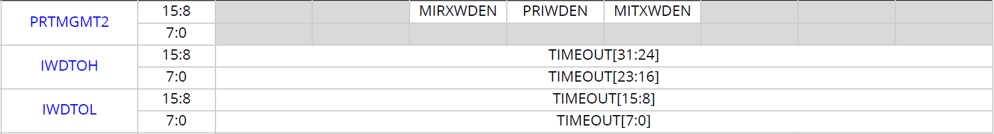
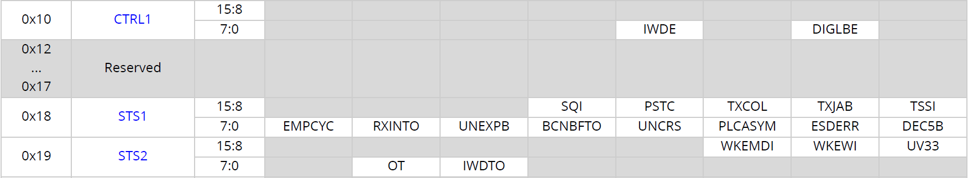
Going to SLEEP – Two Ways
LAN865x or LAN867x automatically goes to SLEEP
when Watchdog timeout occurs
Host actively sets
SLPEN (Sleep Enable) = 1
Host must configure 1...3 inactivity WD sources
No RX from network: MIRXWDEN (Media Interface Receive Watchdog Enable)
No TX to network: MITXWDEN (Media Interface Transmit Watchdog Enable)
No SMI access: PRIWDEN (PHY Register Inactivity Watchdog Enable )
ACTIVE
LAN865x or LAN867x waits for SLPINHDLY
(Sleep Inhibit Delay)
LAN865x or LAN867x releases INH pin
configure IWDTOH / IWDTOH (Inact. WD Timeout)
unmask IRQ_N: IWDTOM = 0
set IWDE = 1 (Inactivity WD Enable)
Power supplies MUST
turn off
SLEEP
In case of any timeout LAN865x or LAN867x
sets IWDTO = 1 (Inactivity WD Timeout Status)
waits for SLPINHDLY, and releases INH pin
Notes:
After wake-up has been configured, the device may at any time be commanded to enter the SLEEP
state. This may be done in one of two ways. The station controller may initiate a transition to SLEEP
by writing a ‘1’ to the Sleep Enable (SLPEN) bit in the Sleep Control 0 (SLPCTL0) register. Alternatively,
the device may be configured to enter SLEEP automatically upon expiration of an inactivity watchdog.
The inactivity watchdog can be configured to trigger on inactivity of three sources: no receive
packets from the network, no transmit packets from the MAC, and no SMI access by the controller.
Each of these three inactivity sources may be enabled separately or together in any combination.
Once enabled, the watchdog timer will be reset upon detected activity on any of the selected
watchdog sources. When the watchdog expires, the Inactivity Watchdog Timeout (IWDTO) bit in
the Status 2 (STS2) register will be set commanding the transition to the SLEEP state and initiating
the Sleep Inhibit Delay timer.

Slide 53
Wake – Sleep Cycle
Check if WAKEIND (Wake Indication) = 1,
in case of a wake event:
check WKEWI (wake over Wake IN),
check WKEMDI (wake over MDI)
VDDA/P/U = ON,
INH = 1
Inactivity watchdog timeout or
app sets SLPEN (Sleep Enable) = 1
Wait for SLPINHDLY (Sleep Inhibit Delay)
Then release INH pin.
Power supplies turn off
if WAKEIND (Wake Indication) = 1,
set CLRWKI (clear wake indication) = 1
to activate wake-detection for the next wake-up
ACTIVE
SLEEP
Device in SLEEP
VDDAU = ON,
INH = 0
WAKE_IN asserted or
any activity detected on MDI
Drive INH = 1
VDDA/P/U = ON

Slide 54
New Wake/Sleep
LAN8670/1/2 Rev D
LAN8650/1 Rev C

Slide 55
Going to SLEEP – Only One Way
Host actively sets
SLPEN (Sleep Enable) = 1
ACTIVE
LAN865x or LAN867x waits for SLPINHDLY
(Sleep Inhibit Delay)
LAN865x or LAN867x releases INH pin
SLEEP
Notes:
After wake-up has been configured, the device may at any time be commanded to enter the SLEEP
state. This may be done in one of two ways. The station controller may initiate a transition to SLEEP
by writing a ‘1’ to the Sleep Enable (SLPEN) bit in the Sleep Control 0 (SLPCTL0) register. Alternatively,
the device may be configured to enter SLEEP automatically upon expiration of an inactivity watchdog.
The inactivity watchdog can be configured to trigger on inactivity of three sources: no receive
packets from the network, no transmit packets from the MAC, and no SMI access by the controller.
Each of these three inactivity sources may be enabled separately or together in any combination.
Once enabled, the watchdog timer will be reset upon detected activity on any of the selected
watchdog sources. When the watchdog expires, the Inactivity Watchdog Timeout (IWDTO) bit in
the Status 2 (STS2) register will be set commanding the transition to the SLEEP state and initiating
the Sleep Inhibit Delay timer.

Slide 56
Wake – Sleep Cycle
Exact indicators will match standard.
Vendor specific registers are not yet defined.
VDDA/P/U = ON,
INH = 1
App sets LPREQ bit in WS_CTRL register.
Wait for SLPINHDLY (Sleep Inhibit Delay)
Then release INH pin
ACTIVE
SLEEP
Device in SLEEP
VDDAU = ON,
INH = 0
Wake event occurred,
Drive INH = 1
VDDA/P/U = ON
Lowest power only
when supplies off

Slide 57
Current vs New Wake/Sleep
LAN8670/1/2 Rev D
LAN8650/1 Rev C

Slide 58
Sleep – Direct Comparison
Current
New
Host actively sets SLPEN (Sleep Enable) = 1
Host can activate inactivity watchdog
No RX from Network
No TX to Network
No PHY/SMI Register Access
Device waits for SLPINHDLY (Sleep Inhibit Delay)
Device releases INH pin
Host actively sets lpreq = 1 in WS_CTRL register
New register required by OA Spec
Device waits for SLPINHDLY (Sleep Inhibit Delay)
Device releases INH pin

Slide 59
Wake – Direct Comparison
Current
New
Network activity on MDI
External Controller via WAKE_IN
Wake Forwarding:
External Controller/PHY on WAKE_OUT
Network via MDI activity
Wake-Up Tone on MDI
External Controller via WAKE_IN
Wake Forwarding:
External Controller/PHY on WAKE_OUT
Network via MDI Wake-Up Tone

Slide 60
Agenda

Slide 61
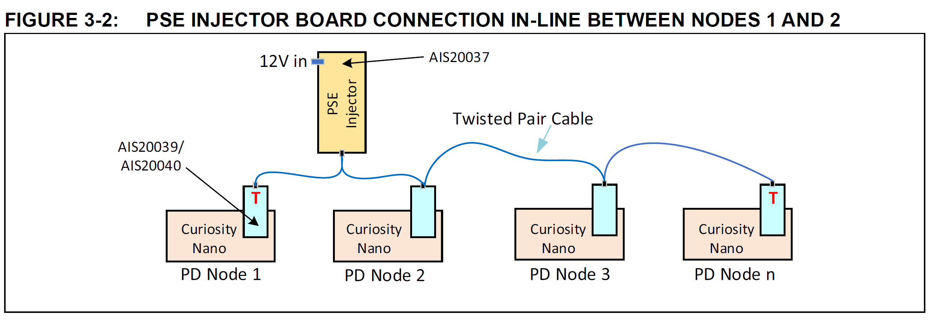
PoDL – Power over Data Line
PoDL for multidrop networks is not specified in IEEE802.3cg, but only for 10BASE-T1L and 10BASE-T1S point-to-point
Number of nodes, stub length, bus length consume margin of signal integrity and robustness (incl EMC/EMI)
PoDL would be an engineered system, customer is in charge.

Slide 62
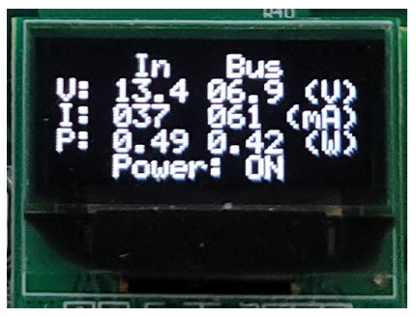
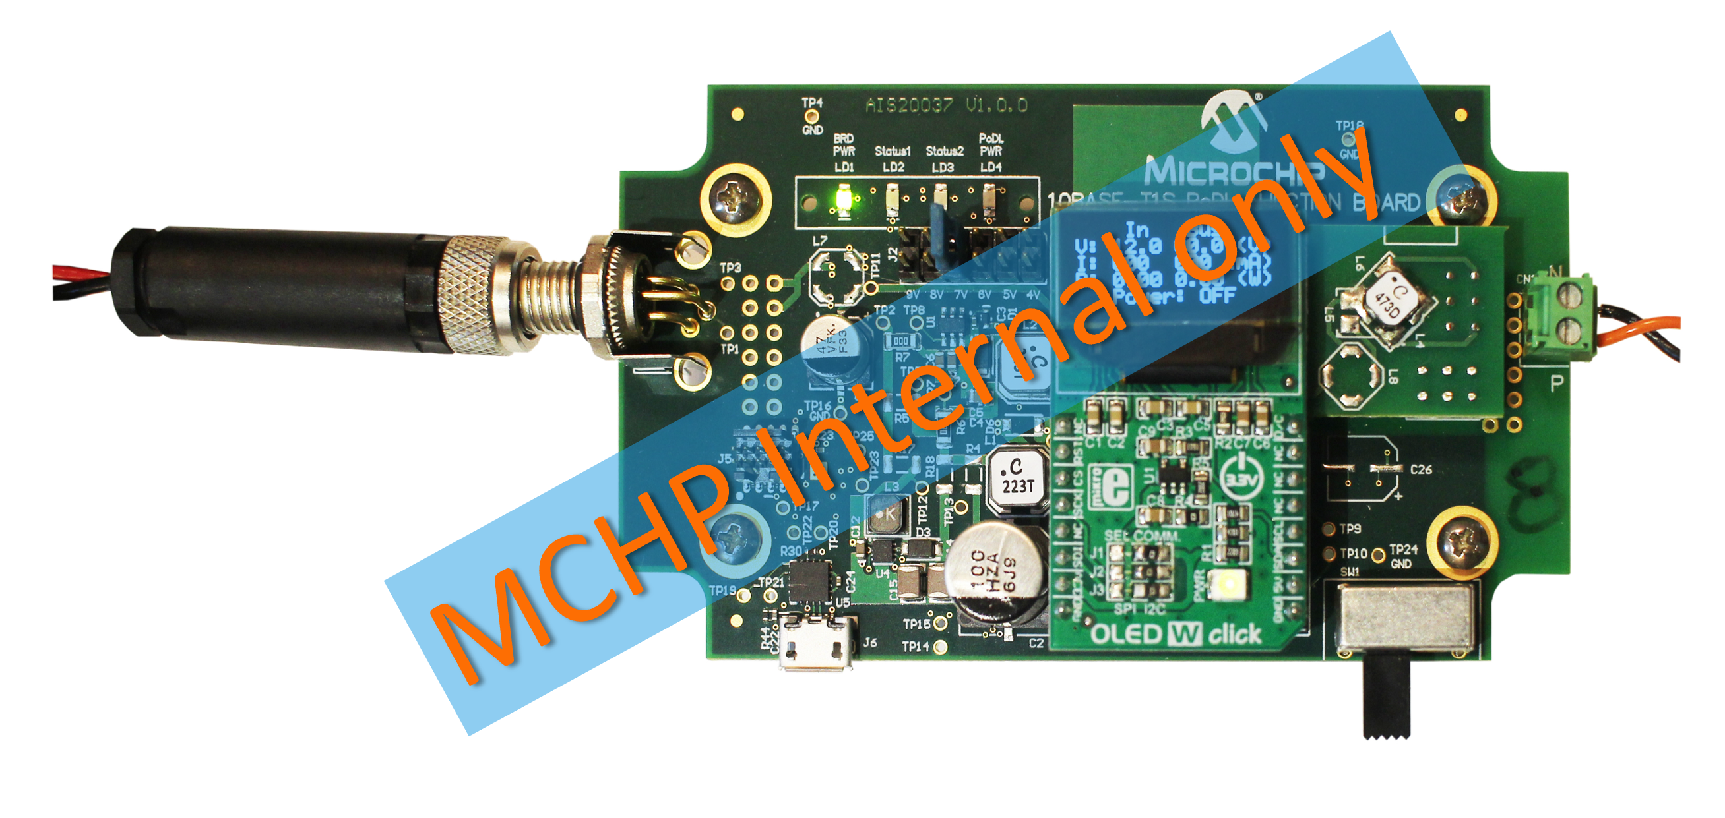
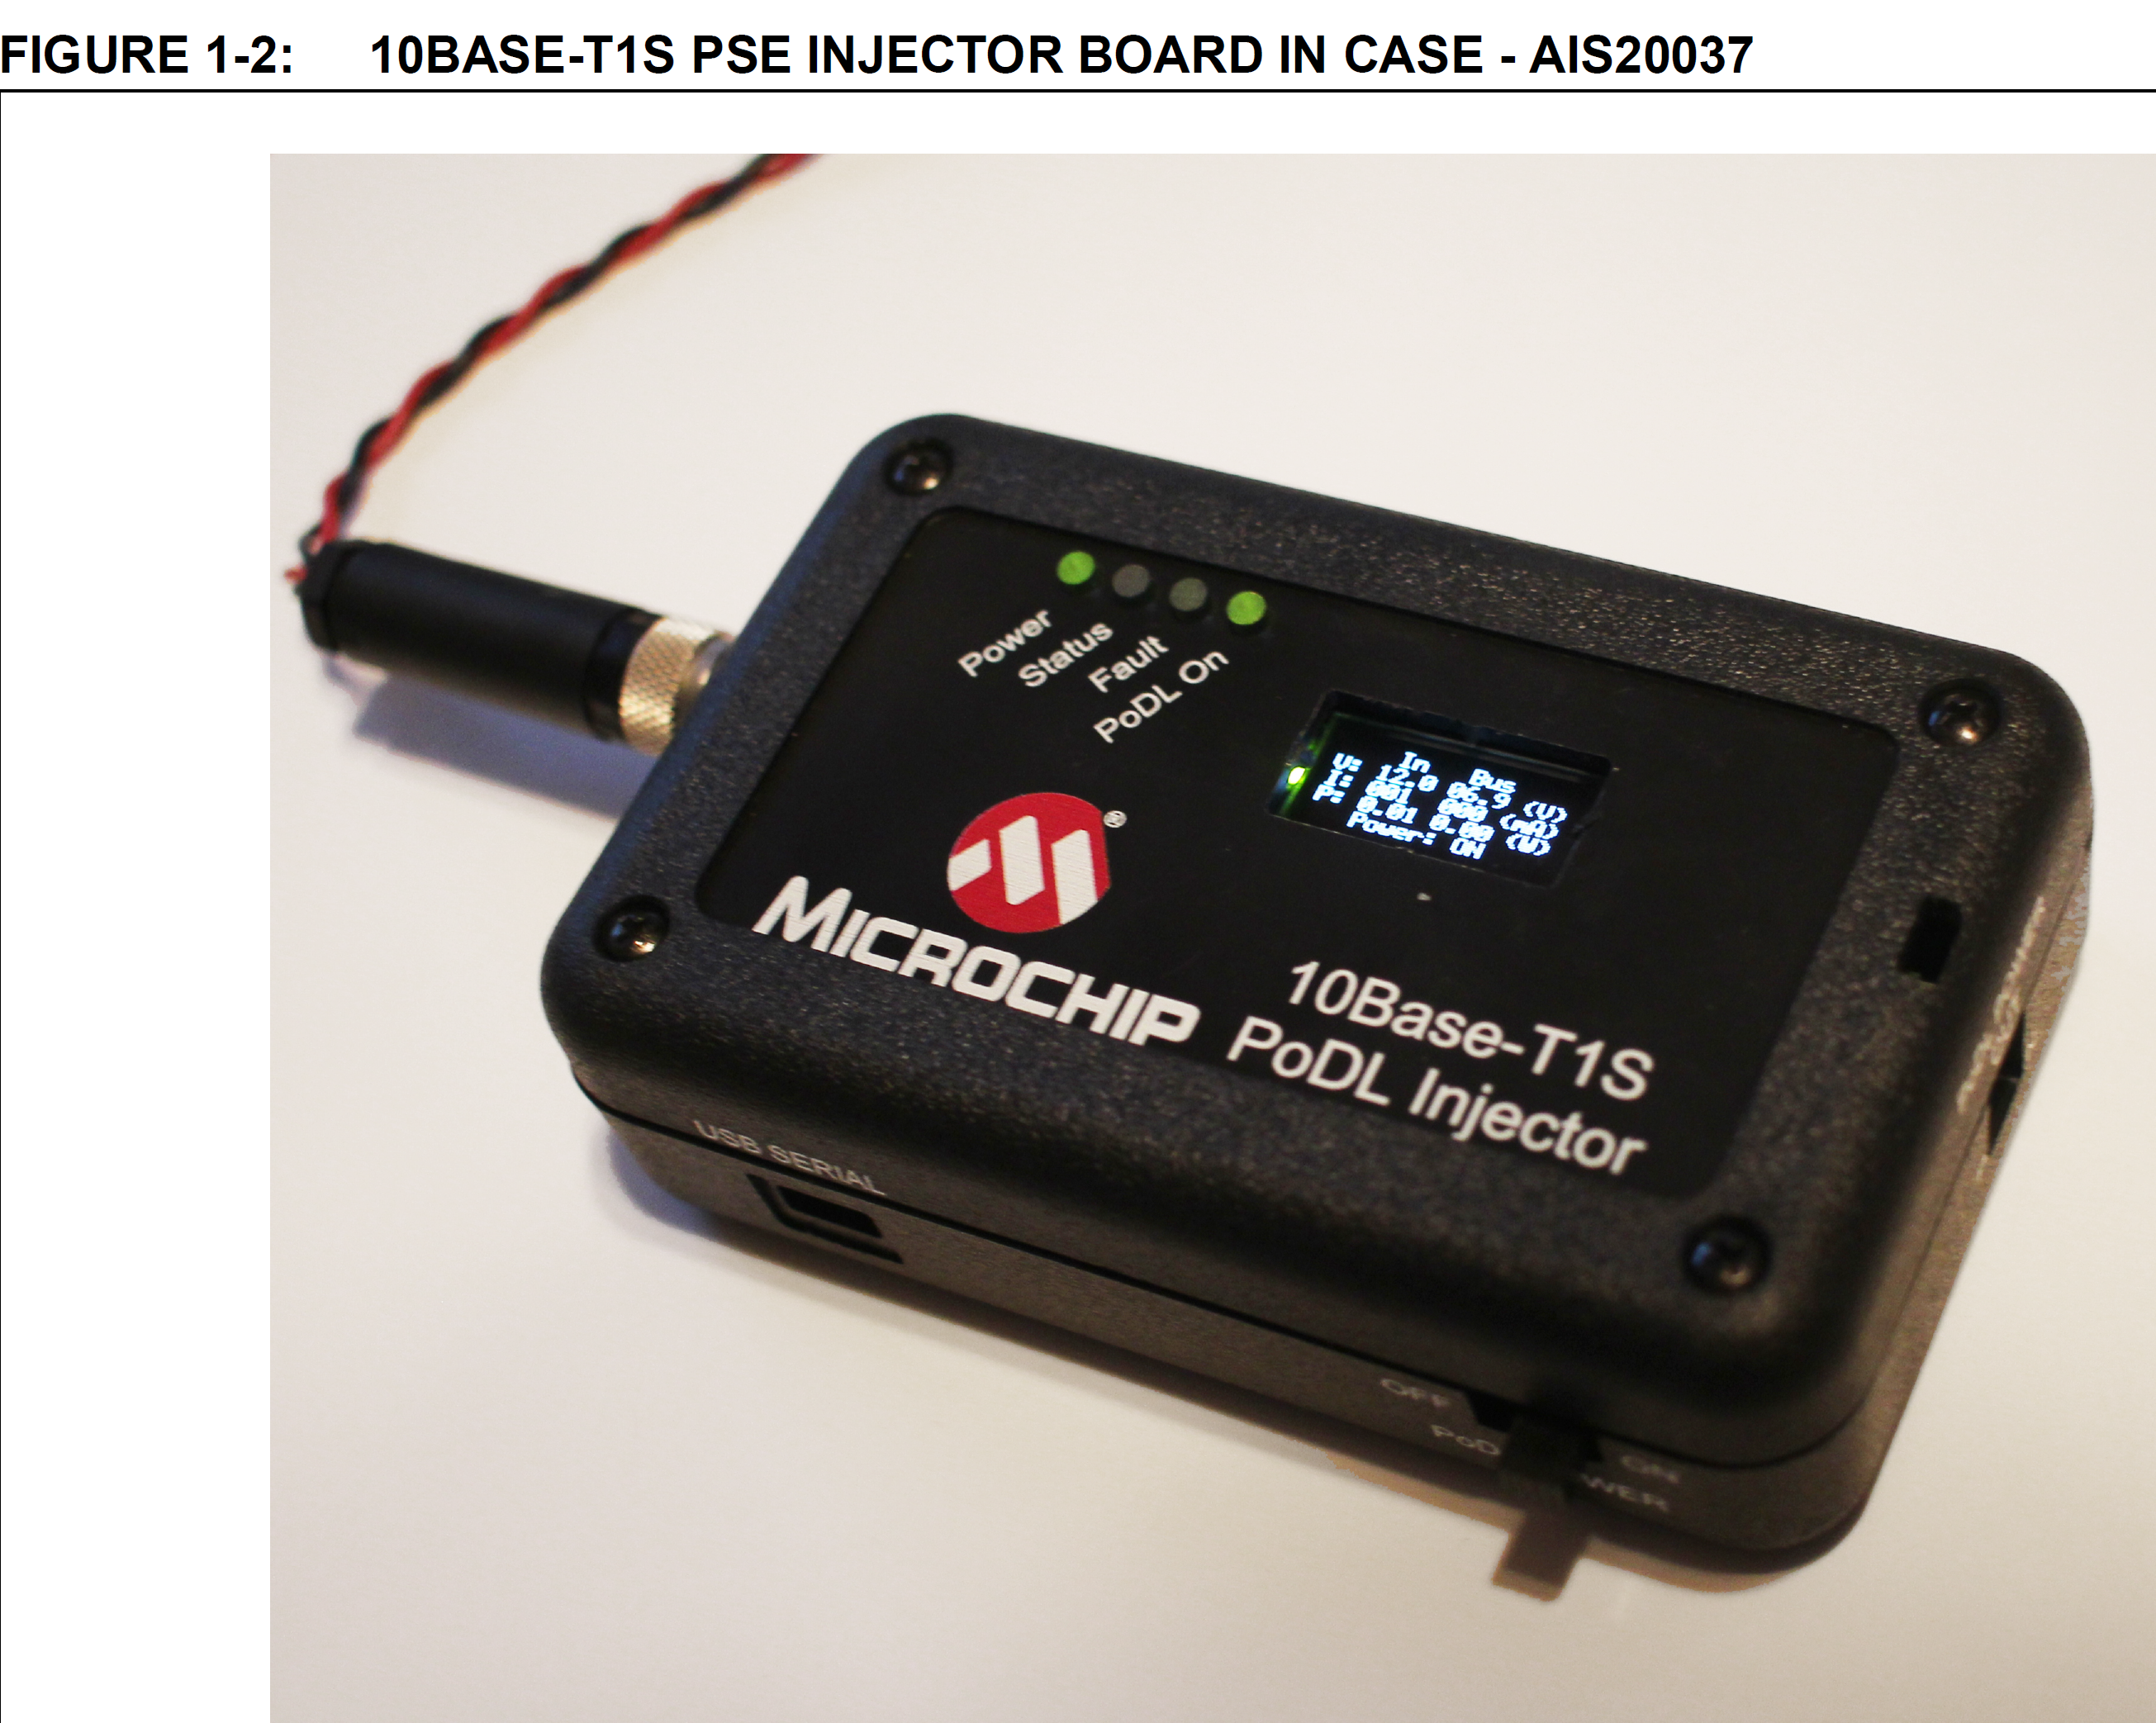
PoDL Power Sourcing Equipment (PSE) – Internal Test Boards Only
PoDL output power
4 - 24V / max 1600 mA
Configurable via jumpers
Display shows current power
10BASE-T1S interface
10BASE-T1S bus termination via jumpers

Slide 63
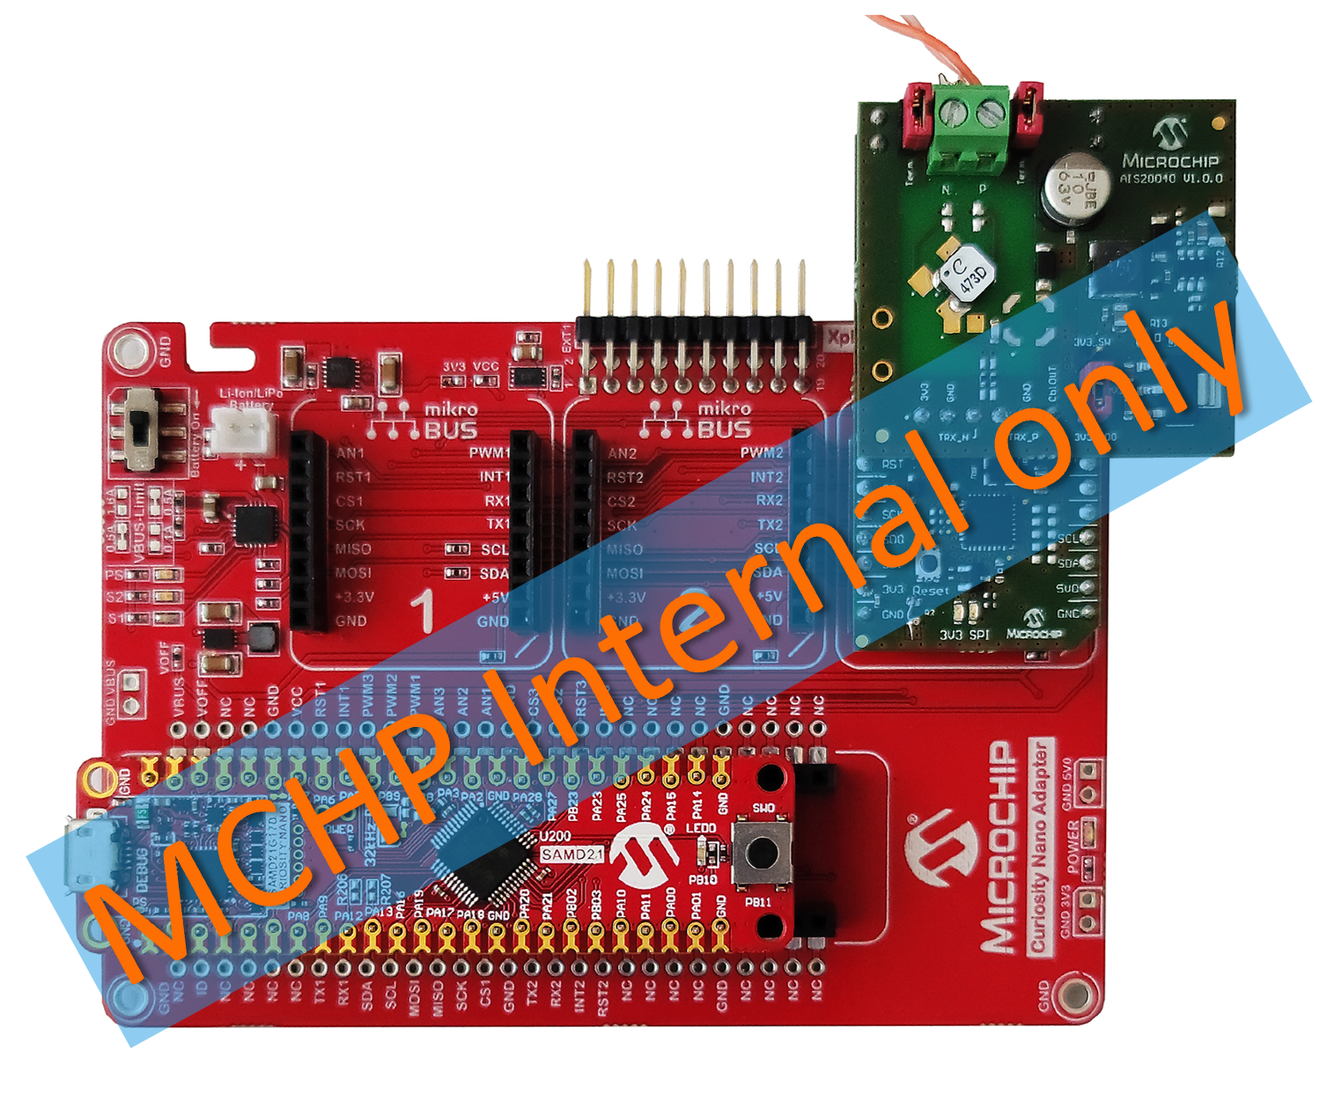
PoDL Powered Device (PD) – Internal Test Boards Only
PoDL Board AIS20040
3.3V / 150 mA LDO
3.3V / 500 mA switched power,
Bus termination via jumpers
LAN8651 node AIS20039
mikroBUS™ clickboard™
5V / 500 mA optional
Voltage regulation via jumpers
Curiosity Nano Base Board
SAMD21 Curiosity Nano Microcontroller board

Slide 64


Slide 65
Thanks for your time!
Do you have any questions?

